Slide 1




GROUP PROJECT

Slide 2


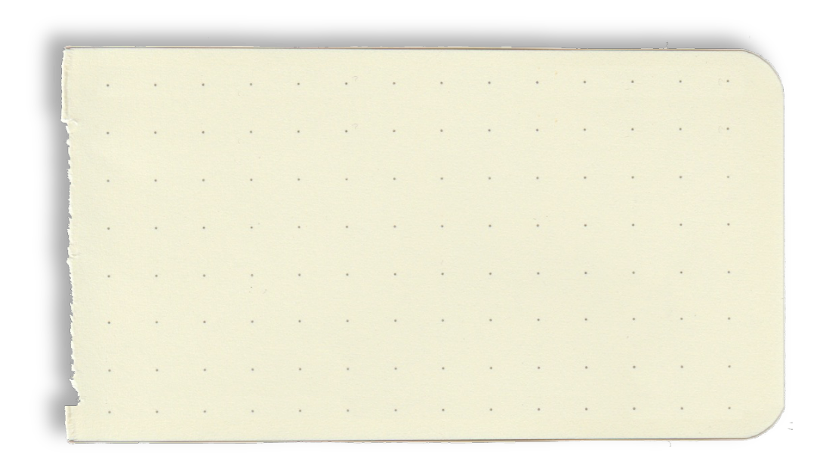

Members
Lê Trọng Vinh ITCSIU23045
Nguyễn Phước Được ITCSIU23005
Nguyễn Đức Quốc Anh ITITWE20018

Slide 3
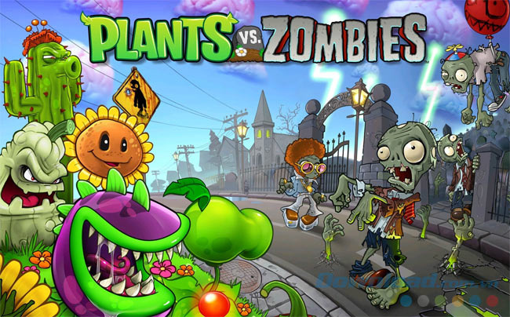
Introduction
Plants vs Zombies was released on 5/5/2009. The game is a tower defense video game developed by PopCap Games.
The object of the game is to collect a currency called "sun" to buy plants. If a zombie passes all your defenses, the level is considered fa﻿iled, and the player will have to restart the level there.

Slide 4
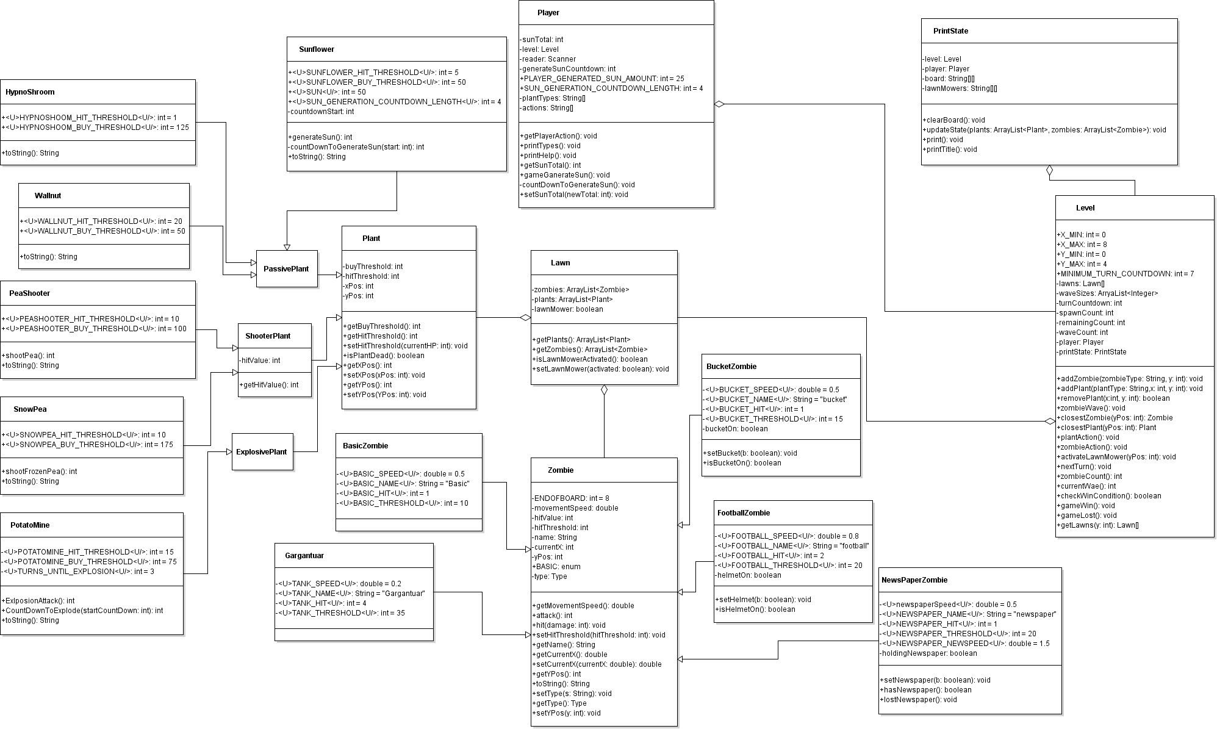
UML:

Slide 5






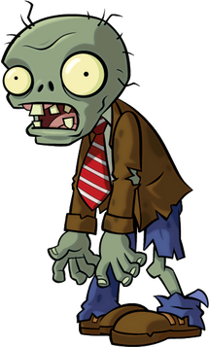
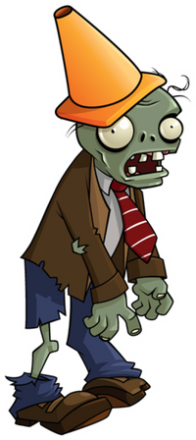
Plants
Items
Zombies
that are used in our projects

Slide 6
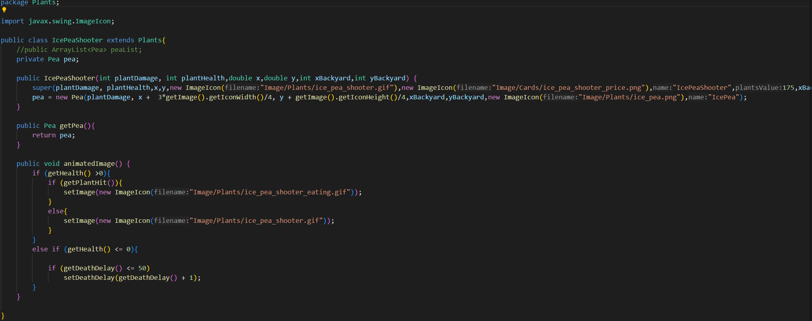

Slide 7
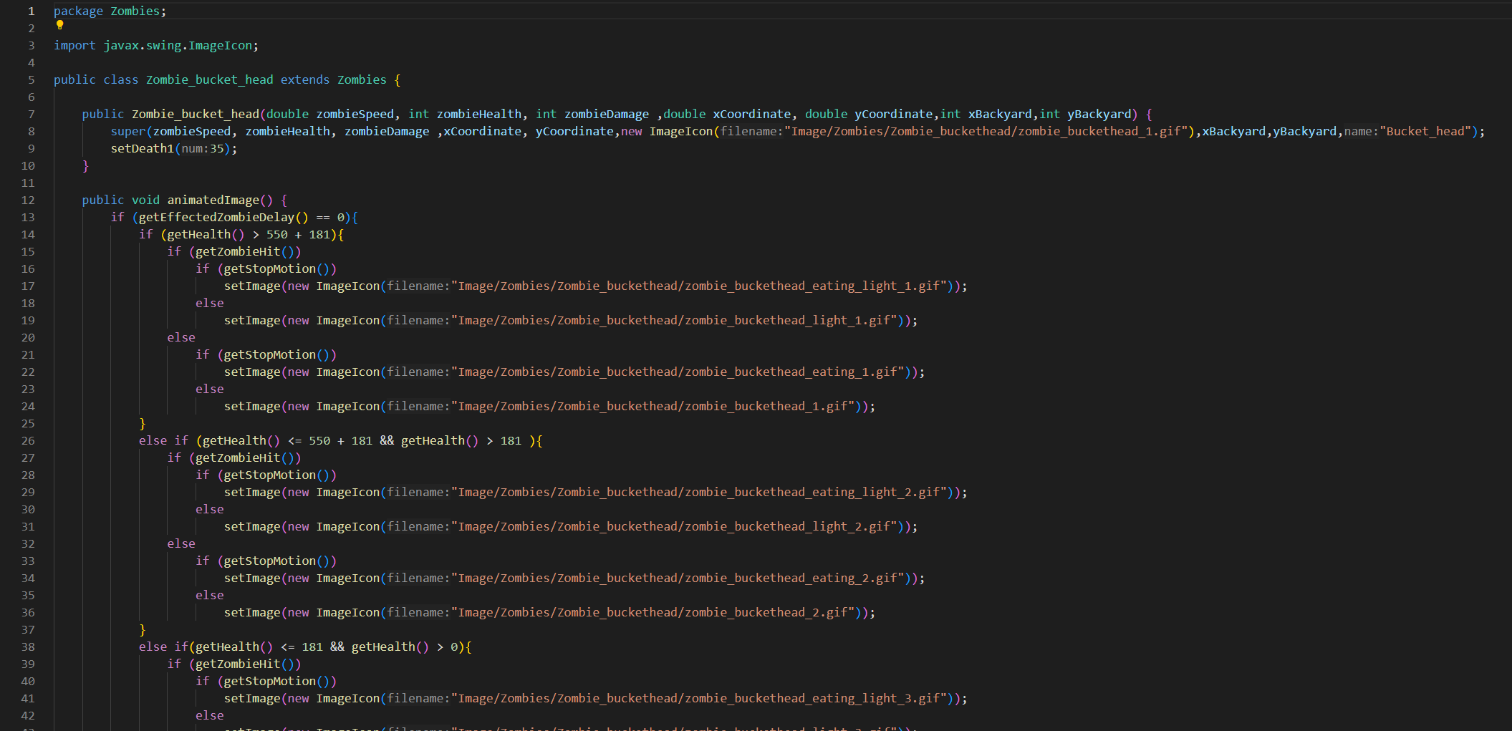

Slide 8
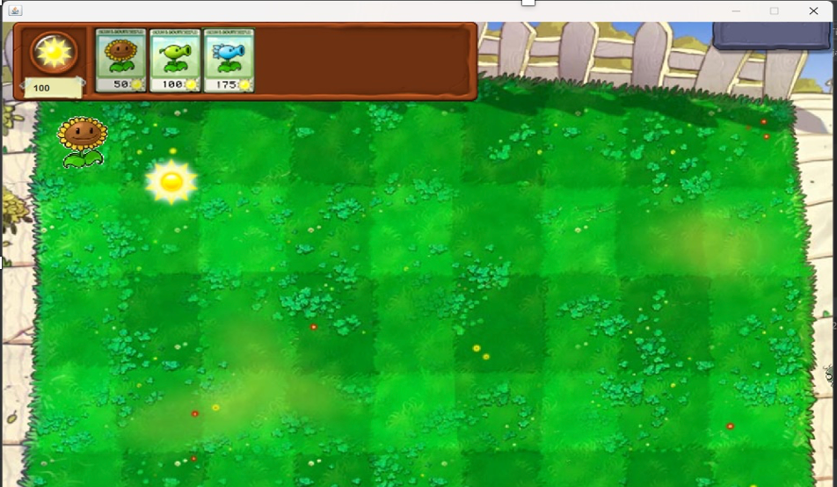
• At the beginning, players should try to develop themselves a lot of Sunflowers to be able to get the sun and earn money to buy weapons:
HOW TO PLAY

Slide 9
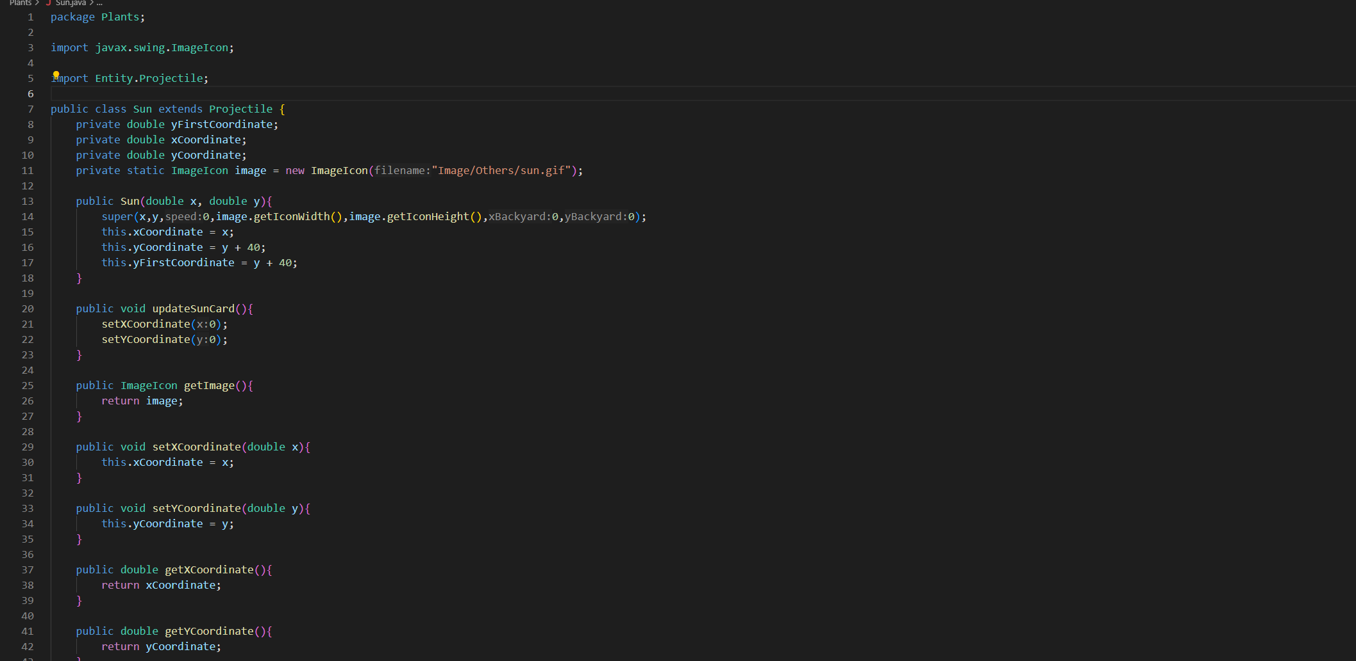

Slide 10
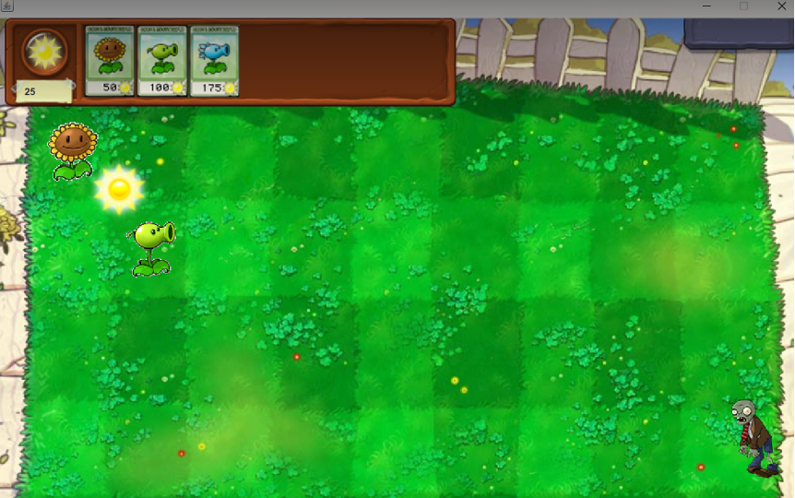

·Every 5s a sun will drop randomly at the top of the game and every 15s a sun will spawn from the sunflower. From there players will use sun to buy peashooter to quickly kill zombies

Slide 11
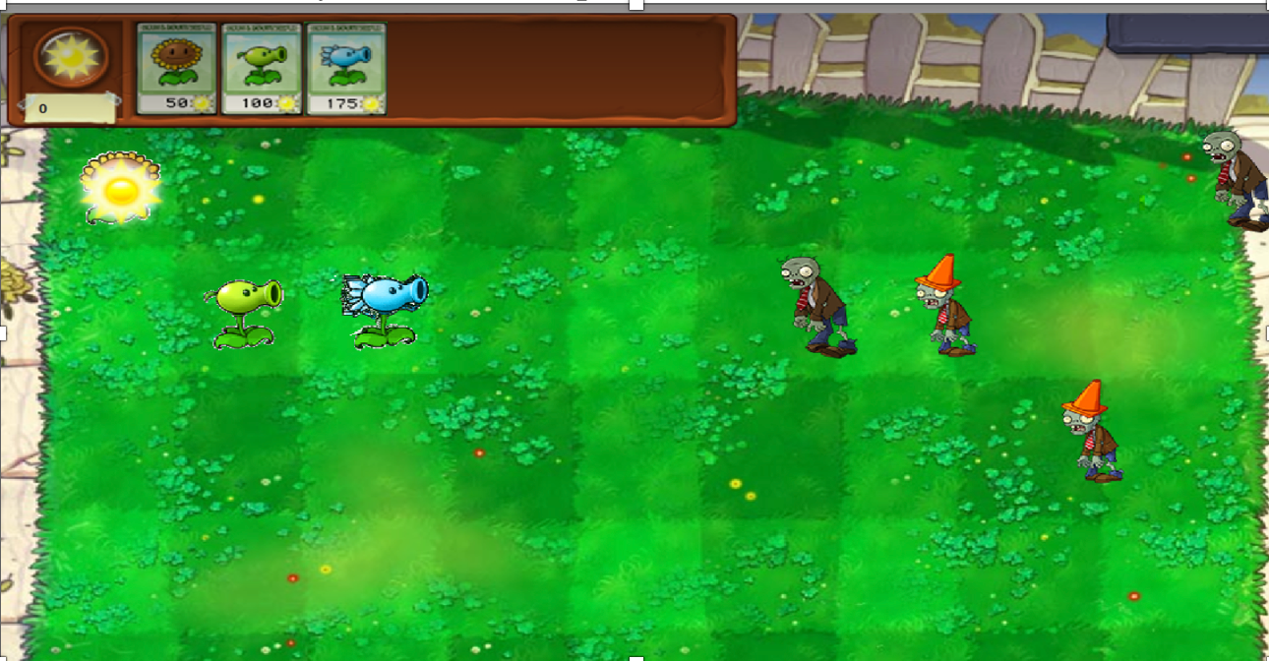
· The difficulty will increase because there is a new stronger zombie, we need to continue to accumulate sun to buy a new type of plants that is freeze peashooter. freeze peashooter can slow down zombies and can buy more time for peashooters to shoot:

Slide 12
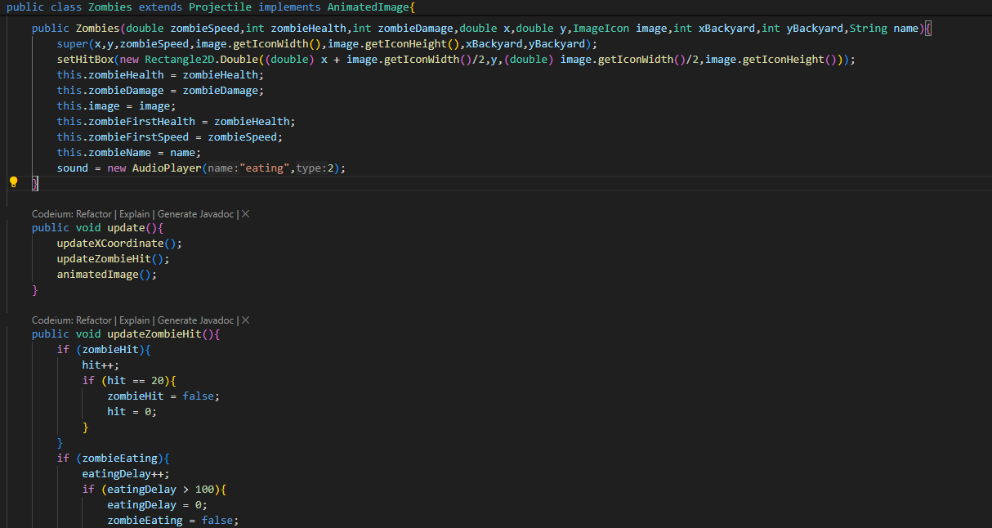

Slide 13
PROJECT ANALYSIS

Slide 14
Class
analyzing

Slide 15
GameState:
- GameState is the main class in the game, It extends from JFrame to display the game screen for user interaction.
- This class has several attributes and methods to manage the game state and actions.
·
Key attributes include:
·GS: a variable to represent the GameWindow class.
·PlantType: it represents all trees of enum data type such as Sun Flower, Pea Shooter, and Freeze Pea Shooter.
Methods include:
GameState(): this method creates a game screen and it consists of several classes like PlantCard, and GamePanel.
·Gamestate(Boolean b): the method will create a menu screen for the user to select the game mode and it contains a Menu class.
·begin(): method will close the menu screen and start the level when the user clicks on “Adventure” mode.

Slide 16
GamePanel:
-This class implements MouseMotionListener to help the user use the mouse to interact with the plant tag and plant the tree.

Slide 17
bgImage, peashooterImage, freezePeashooterImage,... these properties are of the Image data type and they all represent the images of plants, peas, zombies, and gardens.
Colliders: is an Array to display the garden plot has a total of 45 squares. (5 rows and 9 columns).
laneZombies and lanePeas: These properties use the ArrayList data type to represent zombies and peas that appear in 5 rows.
activeSuns: is an ArrayList data type that shows how the sun behaves like falling to a random position, disappearing, or appearing from the sunflowers.
redrawTimer, advancerTimer, sunProducer, zombieProducer: is the Timer data type to set the time to repeat in the delay time. (Ex: time delay=5000, 5000/1000= 5 seconds)
sunScoreBoard: is a JLabel data type and it shows the sun score on the board.
mouseX, and mouseY: are an int data type, that represents the position of the mouse.
sunScore: is an int data type and it will update the sun score when the score is used or collected.
Progress: is an int data type that will count to 150 and stop to show the challenge is done. (1 zombie = 10)
KEY ATTRIBUTES INCLUDE:

Slide 18
getSunScore(): will update the sun score.
setSunScore( int sunScore): change the sun score when the user uses or collects.
GamePanel( sunScoreboard JLabel): create a sun scoreboard, 45 squares with a loop command, and a garden to plant trees. It also creates a time loop for the sun maker, zombie maker, redraw timer, and advanced timer. Besides, this class accesses the image file to get an image of each of the above properties and creates a list of 5 arrays for zombie and bean sugar.
advance(): to make the zombies and peas of 5 rows active at the same time.
paintComponent(g Graphics): method to draw the appearance of plants such as: planting trees and zombies.
mouseMoved(e: MouseEvent): support the user use the mouse to plant trees.
setProgress(num: int): to display a notification when a player reaches a score equal to or greater than 150.
METHOD INCLUDES

Slide 19
Level Data:
- The class develops a difficult game mode for players.

Slide 20
Key attributes include:
Lvl: is a String data type and it equal to “1”. It means that this is the easy level.
Level [] []: is a String data type and it is created by 2 Arrays. It contains two types of zombies such as: normal zombies, normal zombies, and cone-headed zombies (the second array ensures that the spawn rate of the cone-headed zombies is small and makes the game easier.)
LevelValue [] [] []: is an int data type and it has 3 arrays to make normal zombies appear more than hat-headed zombies.
Methods include:
LevelData(): create a file that stores the levels the player has played.
write(String lvl): to update the data of players who have passed the stage and move on to the next stage.

Slide 21


